Slide 1
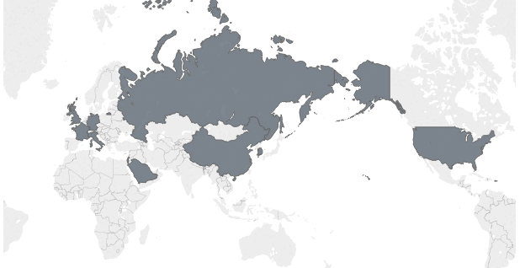
Military Spending of the World
DATS 6103 - Individual Project - Poornima Joshi
15th October 2018

Slide 2
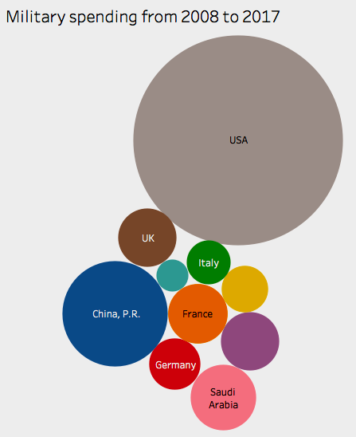
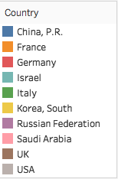
In In this project, we looked at military spending of 10 nations from 2008 to 2017
In this project, we looked at military spending of 10 nations.
USA
China
Russia
Germany
UK
France
Italy
Saudi Arabia
South Korea
Israel

Slide 3
Aim
Comparing the data to the overall military spending of the all 10 countries
Comparing the data to that country’s GDP
Comparing the per person military spending to the per person GDP
Single out the fastest growing countries in military spending in fixed value and in percentage

Slide 4
Data Sources
Data for the military expenditure is taken from Stockholm International Peace research institute’s (SIPRI) Military expenditure database. It is a time series on the military spending of countries for the period 1949–2017. Constant USD is used during the analysis.
Data for the GDP was taken from the World Bank - a leader in global economic data.

Slide 5
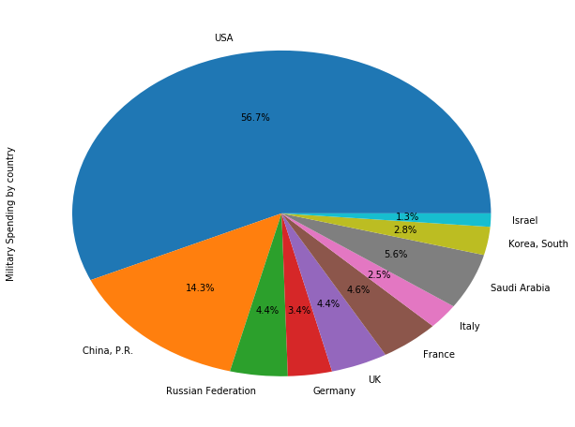
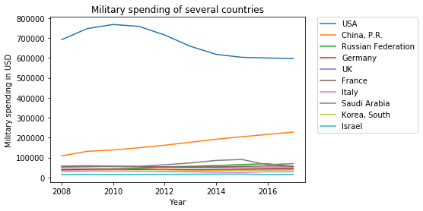
Comparing the data to the overall military spending of the all 10 countries.
Military spending in the USA is the highest with $597178 million in 2017. USA’s military spending makes up 56.7% of the total in the selected countries. The military expenditure was highest in 2010 with $768466 million and a small dip from 2011 onwards
In the second place comes China with $228173 million in 2017. China’s military makes up 34.3% of the total in the selected countries. The military expenditure is highest in 2017 and constantly grown every year since 2008.

Slide 6
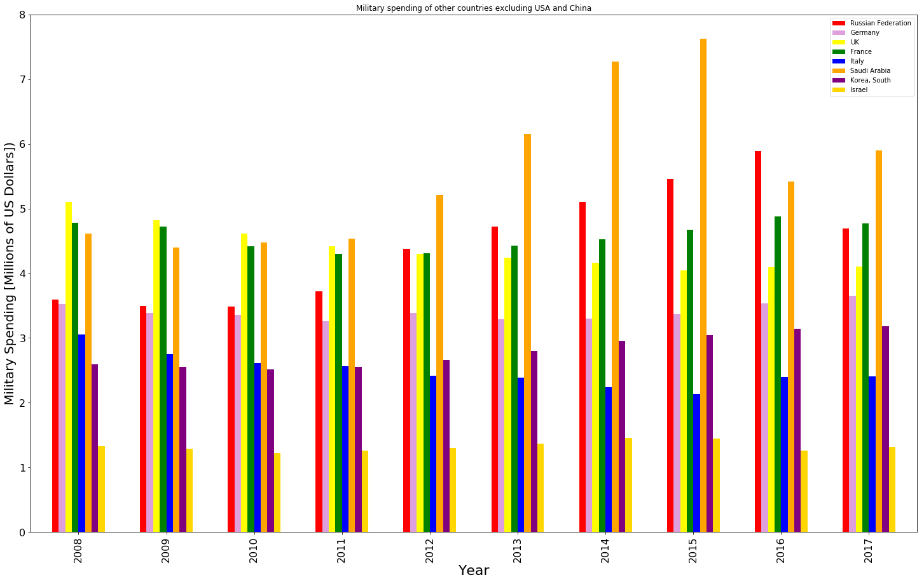
Comparing the data to the overall military spending of the all 10 countries.
Military spending in other countries have been constant from 2008 to 2017. Saudi Arabia shows some increase in 2015 with $90257.9 million.
Saudi Arabia is in the 3rd place, followed by France and Russia. All other countries have been rather consistent in their military expenditure over the years.

Slide 7
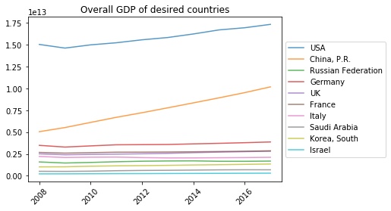
Comparing the data to that country’s GDP
Gross Domestic Product (GDP) is highest for USA and followed by China. We can observe a rapid growth in GDP for China, where as the other countries have been quite consistent from 2008 to 2017.

Slide 8
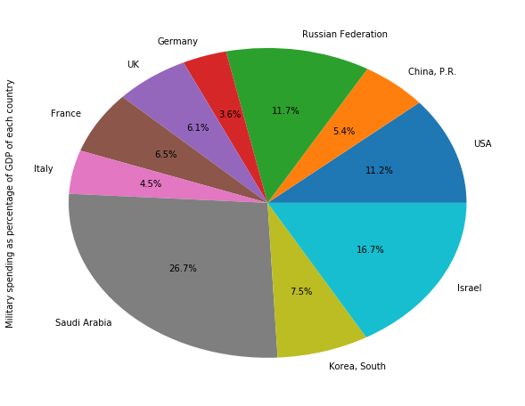
Comparing the military spending as a percentage of the country’s GDP
We can observe that 26.7% of oil rich Saudi Arabia’s GDP is spent on military expenses.
In the second place is Israel with 16.7%, closely followed by USA with 11.2%.
Even though we have noticed that USA has the highest military expenditure, we can see that it spends much lesser on the military expenses when compared to its GDP. China falls even lower with only 5.4%.

Slide 9
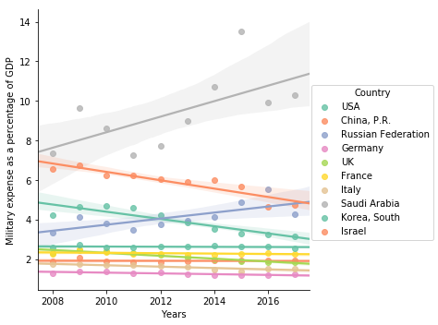
Here we can see the military expenditure for each year. In year 2017, nearly 10.5% of GDP was spend for military in Saudi Arabia. Germany has spend the least percentage of GDP on military to be nearly 1% of GDP.
We can observe a growth in Military expenses for Saudi Arabia from 2011 to 2015 and a slight dip later on. Israel and Russia have been fluctuating in this decade. Most other countries have maintained consistency in their military expenditure as a percentage of their GDP.
We can expect that Saudi Arabia will continue to have nearly 10% of GDP spent on military expenses since the population is only 28.2 million. It has been facing threats from both Iran and the neighbouring states. There is also disturbances in the Yemen region. For a country with such small population and large land, there probably is a need to import weapons and military equipment. Thus, would make us think that the trend is going to continue.

Slide 10
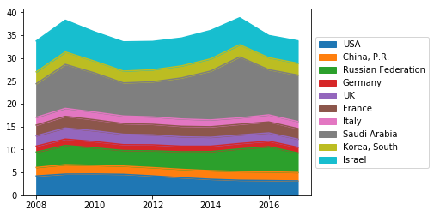

Comparing the per person military spending to the per person GDP
Calculating the per person military spending is nothing but the total military expense of a country divided by the total population. This is also expressed as military spending per capita.
The per person GDP is the total GDP divided by the total population, also expressed as GDP per capita.
We have compared the per person military expense to per person GDP by finding the ratio of the two.
We can observe that, the trend in the ratio is same as that of the military spending as a percentage of the GDP.

Slide 11
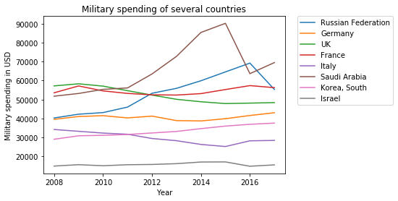
Finding the fastest growing countries in military spending in fixed value
We can observe in the first graph all the selected countries against their total military spending by year.
China is clear winner having the steepest increase in the military expense. From 2008 to 2017 it has increased from $108457 to 228173
But zooming into the lower half in the second graph we can see that they is a peak Saudi Arabia. From 2008 to 2015 it has increased from $51781 to $90257.9 and seen a dip later on.
Russia is also increasing from $40286 to $69245.3 during 2008 to 2016

Slide 12
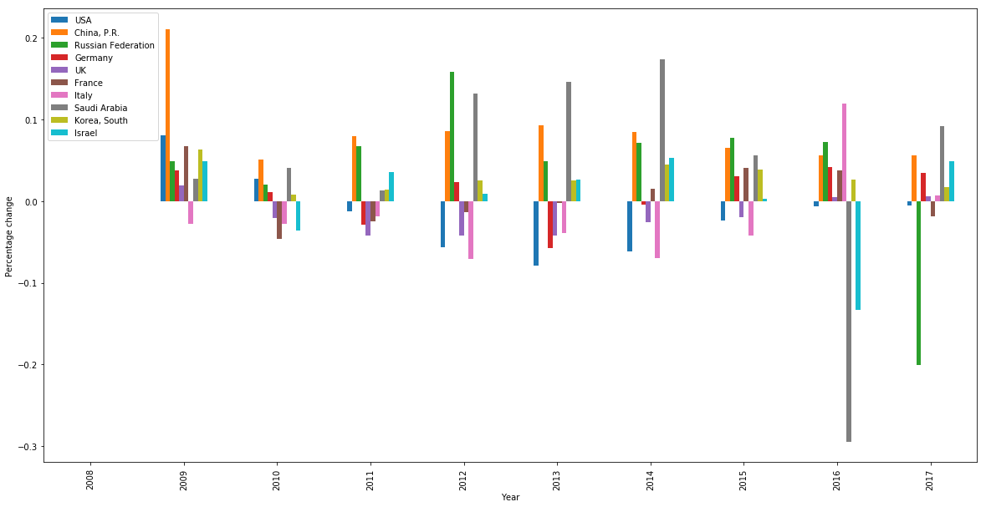
Finding the fastest growing countries in military spending in percentage
When we observe the percentage change for China we see that there is a very big change in 2009.
But on further looking down in 2012 unto 2014, we see that Saudi Arabia has the highest change in percentage, thus making it the fastest growing country in military spending. To support this finding, we can also see in the previous graph that it nearly saw 100% change from 2008 to 2015.

Slide 13
Conclusion
USA has the highest Military spending

Slide 14
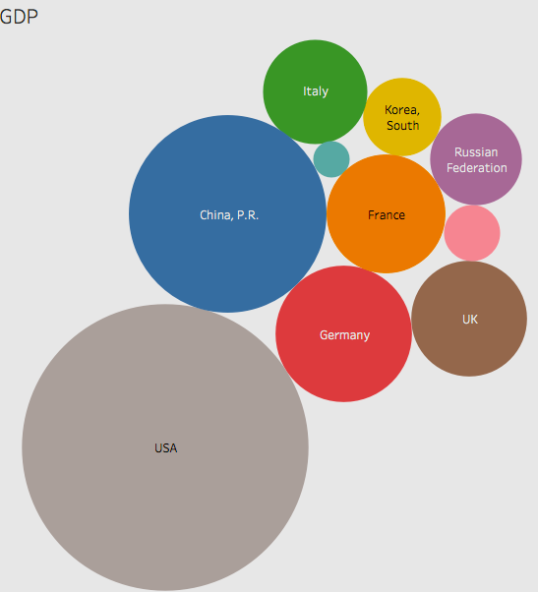
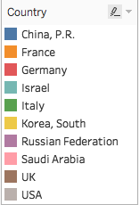
Conclusion
USA has the highest GDP

Slide 15
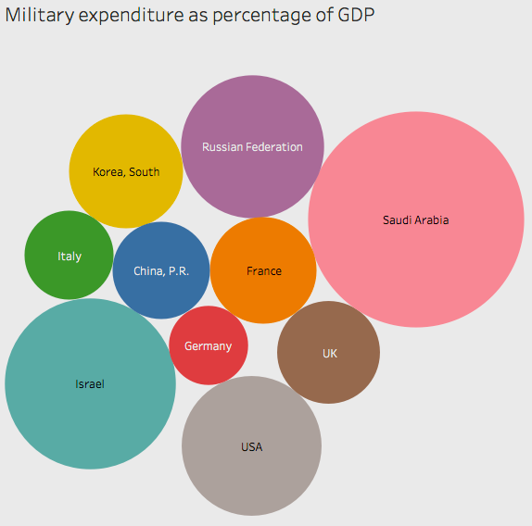
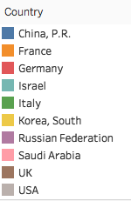
Conclusion
Saudi Arabia has the highest Military spending as a percentage of GDP

